Slide 1
Generative Models vs. Discriminative models

Slide 2
Roughly:
Discriminative
  Feedforward
  Bottom-up
Generative
  Feedforward recurrent feedback
  Bottom-up horizontal top-down

Slide 3
Compositional generative models require a flexible, “universal,” representation format for relationships.
How is this achieved in the brain?

Slide 4
Will discuss above issues through illustrative examples
taken from:
  computational/theoretical neuroscience
  computer vision
  artificial neural networks

Slide 5
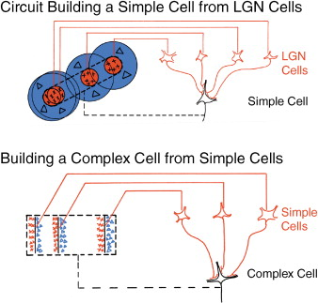
Hubel and Wiesel 1959

Slide 6
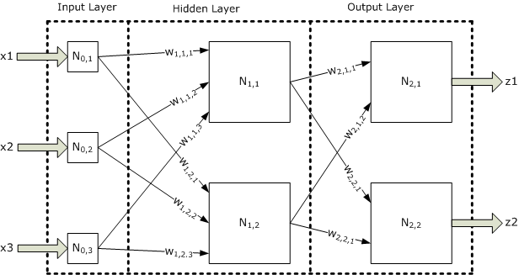
Frank Rosenblatt’s “Perceptron” 1957
The perceptron is essentially a learning algorithm
Multi-layer perceptrons use backpropagation

Slide 7
K. Fukushima: "Neocognitron: A self-organizing neural network model for a mechanism of pattern recognition unaffected by shift in position", Biological Cybernetics, 36[4], pp. 193-202 (April 1980).
HMAX model
Riesenhuber, M. and T. Poggio. Computational Models of Object Recognition in Cortex: A Review, CBCL Paper #190/AI Memo #1695, Massachusetts Institute of Technology, Cambridge, MA, August 2000.
Poggio, T. (sections with J. Mutch, J.Z. Leibo and L. Rosasco), The Computational Magic of the Ventral Stream: Towards a Theory, Nature Precedings, doi:10.1038/npre.2011.6117.1 July 16, 2011
Tommy Poggio
http://cbcl.mit.edu/publications/index-pubs.html
Ed Rolls
http://www.oxcns.org/papers/312_Stringer+Rolls02.pdf

Slide 8
What can feedforward models achieve?
http://cbcl.mit.edu/projects/cbcl/publications/ps/serre-PNAS-4-07.pdf
http://yann.lecun.com/
http://www.cis.jhu.edu/people/faculty/geman/recent_talks/NIPS_12_07.pdf

Slide 9
Where do feedforward models fail?

Slide 10
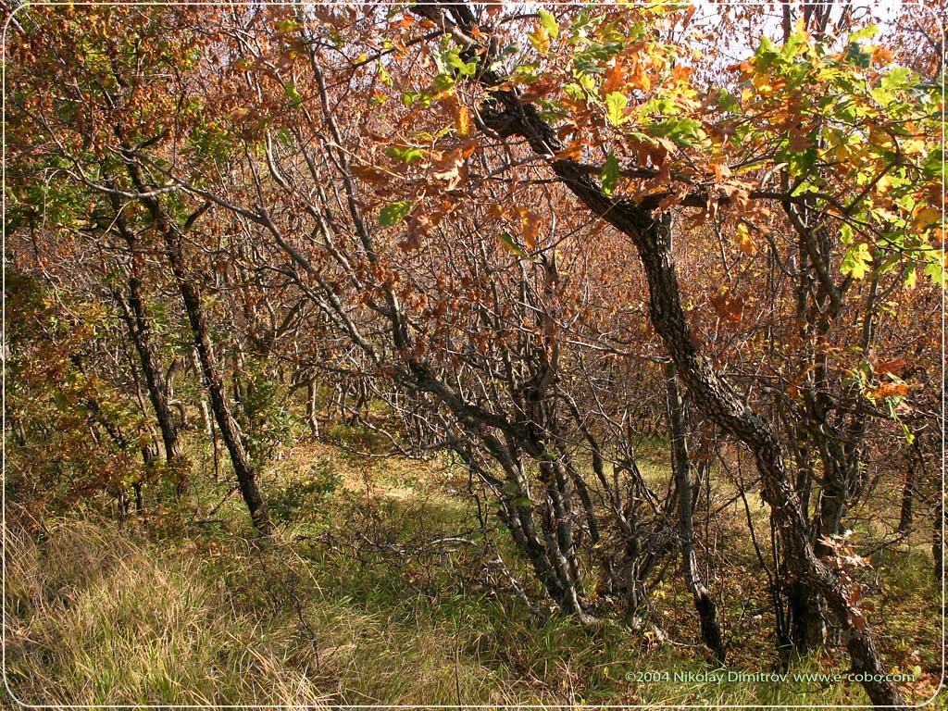
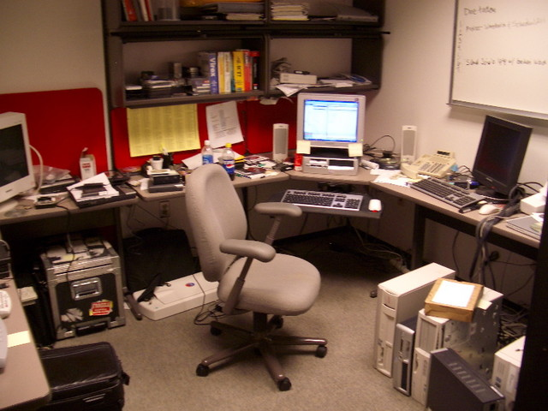
Find the keyboards…
Find the small animals….

Slide 11
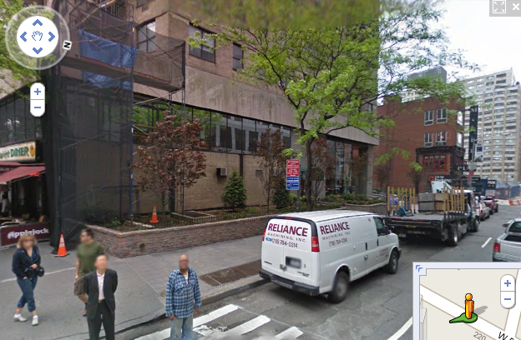
Clutter and Parts
Street View: detecting faces…

Slide 12
Where do feedforward models fail?
in images containing clutter that can be confused with object parts

Slide 13
Why do feedforward models fail?

Slide 14
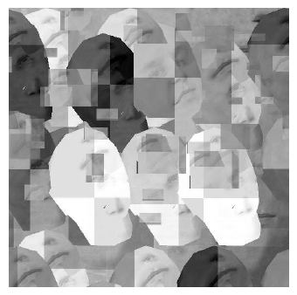
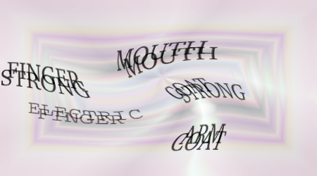
Clutter and Parts
“Human Interactive Proofs”
aka CAPTCHAs

Slide 15
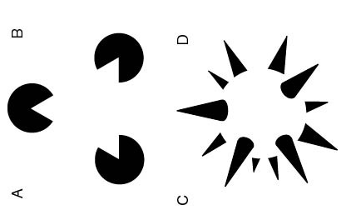
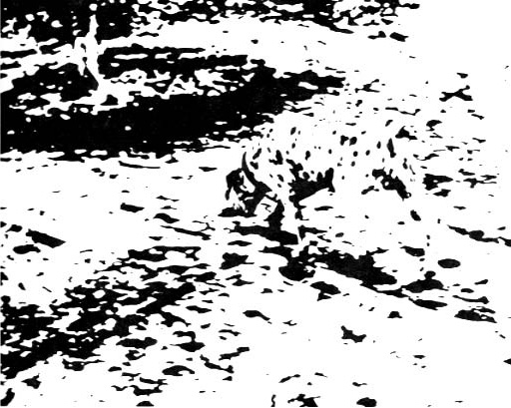
Kanizsa triangle

Slide 16
Context and Computing
Biological vision integrates information from many levels of context to generate coherent interpretations.
How are these computations organized?
How are they performed efficiently?

Slide 17

Context and Computing

Slide 18
Why do feedforward models fail?
Because images are locally ambiguous…
hence the chicken-and-egg problem of
segmentation and recognition: these should drive each other.
  Segmentation is a low-level operation
  Recognition is a high-level operation
Conducting both simultaneously, for challenging scenes (highly variable objects in presence of clutter)
Is the “Holy Grail” of Computational Vision

Slide 19
The difficulty of computational vision
could not be overstated:
Papert’s Summer Vision Project (1966)
The summer vision project is an attempt to use our summer workers effectively in the construction of a significant part of a visual system. The particular task was chosen partly because it can be segmented into sub-problems which will allow individuals to work independently and yet participate in the construction of a system complex enough to be a real landmark in the development of “pattern recognition.”
Papert, S., 1966. The summer vision project. Technical Report Memo AIM-100, Artificial Intelligence Lab, Massachusetts Institute of Technology.

Slide 20
Half a century later…
On 5/3/2011 11:24 PM, Stephen Grossberg wrote:
The following articles are now available at http://cns.bu.edu/~steve:
  On the road to invariant recognition: How cortical area V2 transforms absolute into relative disparity during 3D vision
  Grossberg, S., Srinivasan, K., and Yazdanbakhsh, A.
  On the road to invariant recognition: Explaining tradeoff and morph properties of cells in inferotemporal cortex using multiple-scale task-sensitive attentive learning
  Grossberg, S., Markowitz, J., and Cao, Y.
  How does the brain rapidly learn and reorganize view- and positionally-invariate object representations in inferior temporal cortex?
  Cao, Y., Grossberg, S., and Markowitz, J.

Slide 21
Generative
  feedforward recurrent feedback
  bottom-up horizontal top-down
Compositional generative models:
  flexible, “universal,” representation format for relationships.

Slide 22
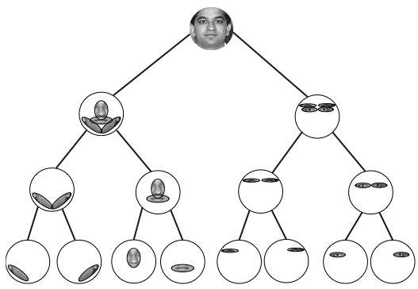
Generative model (cf. Geman and Geman 1984)

Slide 23
Mathematical tools
  Collection of random variables organized on graph (often a “tree” or a “forest” of trees)
  Unconditional (independent) probabilities for the “cause” nodes (the “roots”of the trees)
  Conditional probabilities on daughter nodes, given the state of parent node
  Bayes theorem for inference
  EM algorithm (Expectation Maximization) for learning the parameters of the model

Slide 24
Example of a generative model
from the work of Stu Geman’s group…

Slide 25
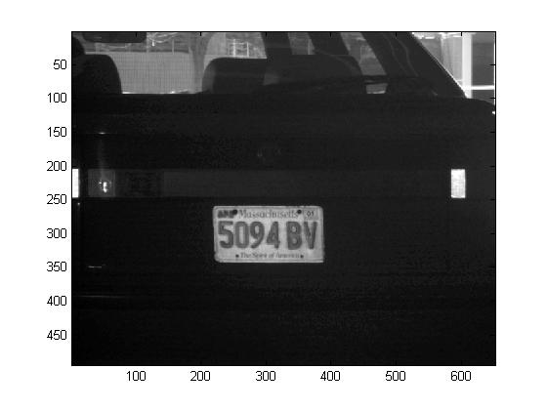
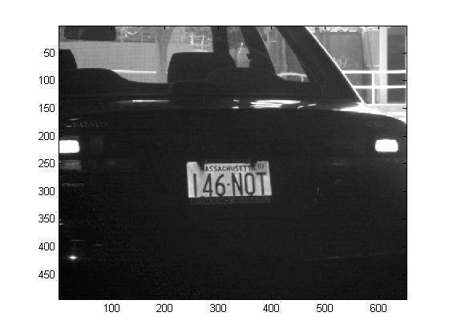
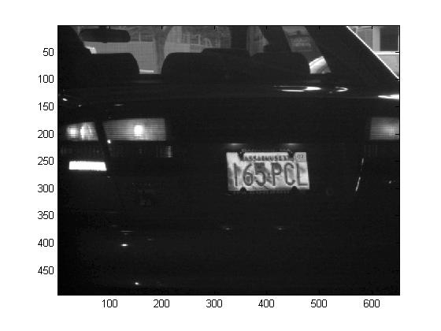
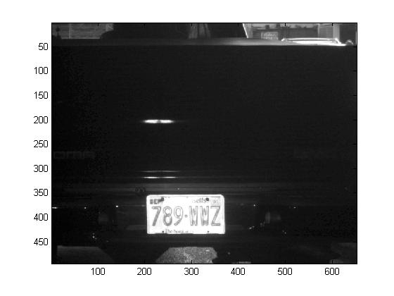
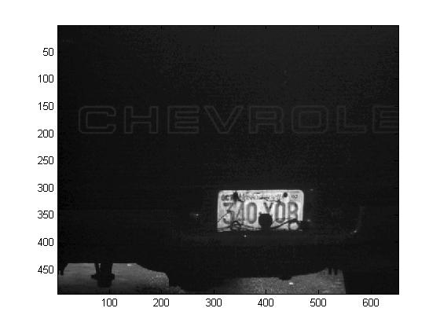
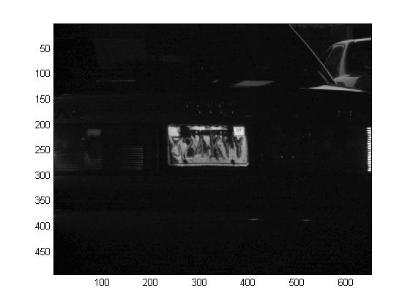
Test set: 385 images, mostly from Logan Airport
Courtesy of Visics Corporation

Slide 26
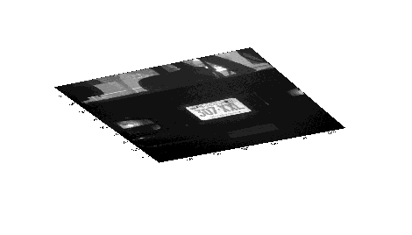
Architecture
license plates
license numbers (3 digits + 3 letters, 4 digits + 2 letters)
plate boundaries, strings (2 letters, 3 digits, 3 letters, 4 digits)
generic letter, generic number, L-junctions of sides
characters, plate sides
parts of characters, parts of plate sides

Slide 27
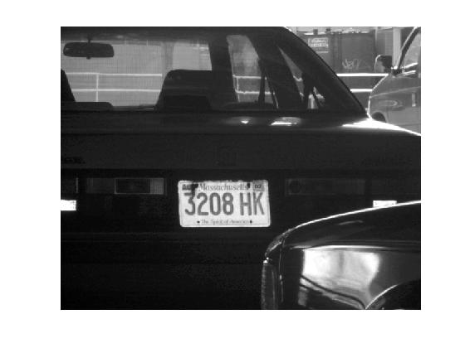
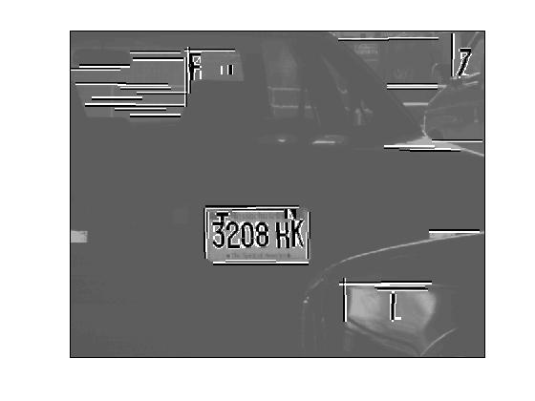
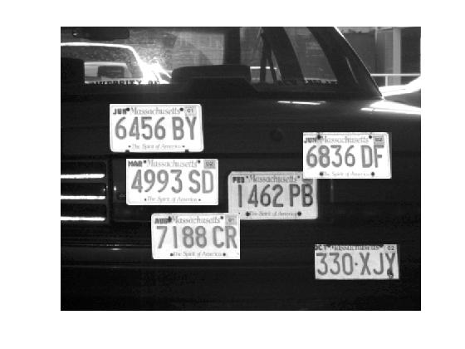
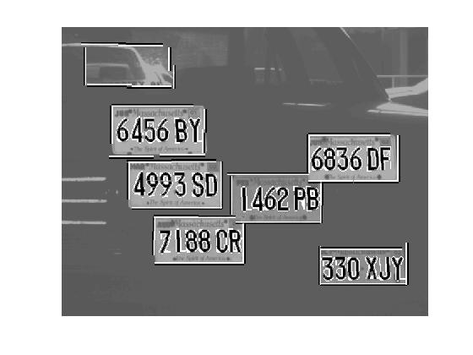
Image interpretation
Original Images
Instantiated Sub-trees

Slide 28
Performance
385 images
Six plates read with mistakes (>98%)
Approx. 99.5% characters read correctly
Zero false positives

Slide 29
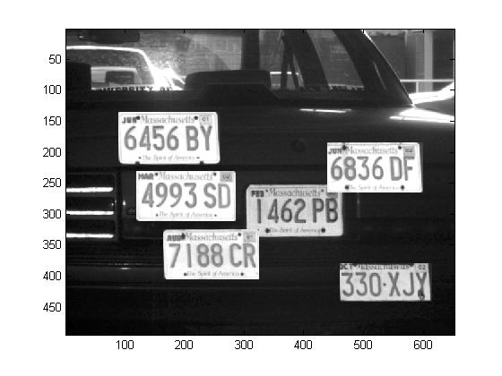

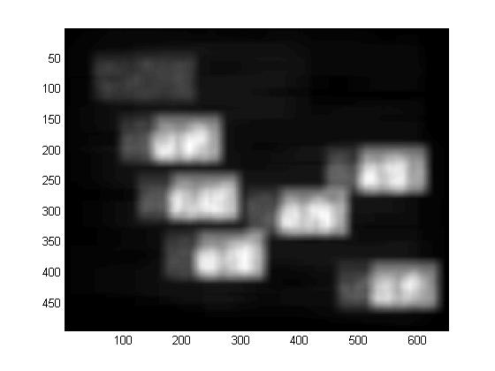
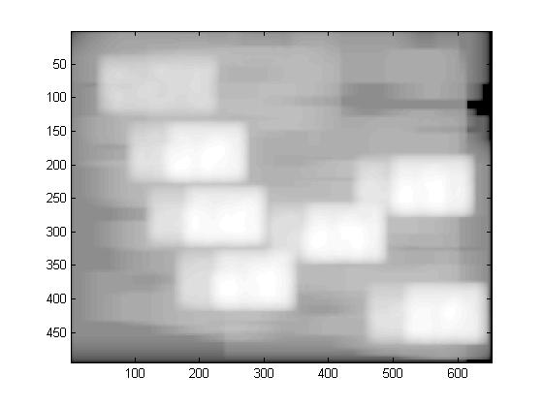
Efficient computation: depth-first search
Test image
Top objects
Number of visits to each pixel. Left: linear scale Right: log scale

Slide 30
Computation and learning are much harder in generative models than in discriminative models.
In a tree (or “forest”) architecture, dynamic programming algorithms can be used.
The general learning (“parameter estimation”) method:
Use your model
Update your model parameters
Iterate
Expectation-Maximization (EM)
(see book for connection to Hebbian plasticity
and wake-sleep algorithm)

Slide 31
EM algorithm for learning a mixture of Gaussians:
Chapter 10 from Dayan and Abbott
  caution:
    observables are “inputs”
    causes are “outputs”
Elementary, non-probabilistic, version: k-means clustering

Slide 32
The Markov dilemma:
On the one hand, the Markov property of Bayesian nets and of probabilistic context-free grammars provides an appealing framework for computation and learning. On the other hand, the expressive power of Markovian models is limited to the context-free class, whereas, as illustrated in the articial CAPTCHA tasks but as is also abundantly clear from everyday examples of scene interpretation or language parsing, the computations performed by our brains are unmistakably context- and content-dependent.
Incorporating, in a principled way, context dependency and vertical computing into current vision models is thus, we believe, one of the main challenges facing any attempt to reduce the “ROC gap” between CV and NV.

Slide 33
