Slide 1
The 1,2,3,4 Game
Sam Freedman (samuel_freedman@brown.edu)
Math CoOp — April 8th, 2020

Slide 2
Objective
Question: Using the digits 1,2,3 and 4 and the operations addition, subtraction and multiplication, which numbers can we make by using each digit at most once?
Examples
5 = 1 + 4
6 = 2 * 3
7 = (1 + 2) * 4
8 = ?
Non-Example
2 = 1 + 1 (uses 1 twice)

Slide 3
Set-up
Materials:
Paper and pencil for each student
Group writing surfaces like a whiteboard or paper on the wall
Groups:
Smaller groups of 2-5 are better
Maybe appoint a “scribe?”

Slide 4
Implementation
Can have one mentor at the board as ”group scribe” guiding the search for new numbers, recording rule changes, etc.
Can have each group maintain its own set of rules and found numbers
Ideally students work together to find new numbers, although student’s comfort with arithmetic varies individually

Slide 5
Rule Modifications
Caution: These are all audience-dependent. Most changes are proposed mid-game
Examples:
Negatives: Use subtraction as a minus sign, so –(3 * 4) is valid
Squares and Cubes: Use the digit 2 for squaring, making (3 + 4)^2 valid
Exponentiation: Allow for 2^3 or 3^(4 + 1)
Fractions: Allow for division as an operation

Slide 6
Goals
Largest possible number?
Smallest possible number?
Smallest number that’s impossible?
Students love trying to make 100 (do you think it’s possible?)
How do we “know” that we found everything?
What if we allow for more starting digits, such as 5?

Slide 7
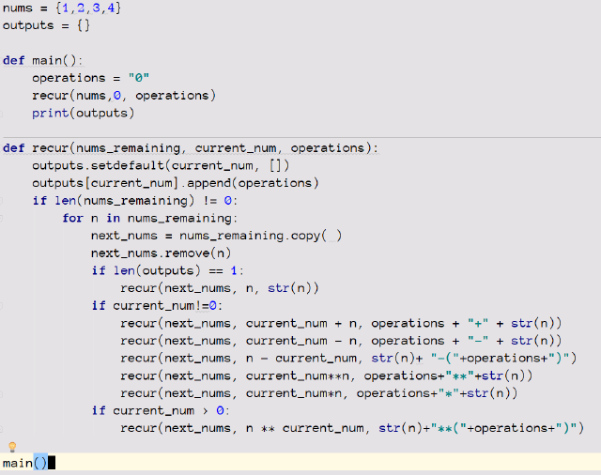
Extension:
Exhaustive Search
Code by Sarah Griffith-Siqueira (Grad Student in Math Department)

Slide 8
Take-Aways
Playing with numbers can be a lot of fun!
Impossibility in math—how do we really know?
In math, you get to make and break the rules.

